Slide 1
University Management
Database System
BATCH NUMBER:04
Presented by:
25B11AI428 - JOJATI BHAKAT 25B11AI009 - ADARSH SIDDHARTH
25B11AI044 – ANIKET KUMAR 25B11AIA46 – SACHIN KUMAR MAHTO
Academic Year: 2026-2027
Under esteemed guidance of
Mr.M Sudheer
Assistant Professor
Department of AIML
Aditya University

Slide 2
Project Overview
The University Management Database System is designed to store and manage important college information in a structured way.
Problem Statement
Managing college information manually or using separate files can create several problems:
Duplicate student and faculty information
Difficulty in finding records
Data inconsistency
Time-consuming updates
Difficult relationship management
Higher chance of errors
Proposed Solution
We propose a centralized relational database that connects students, departments, faculty, courses, enrollment and examination information.

Slide 3
Objectives
Manage student information
Manage department and faculty details
Store course information
Track student enrollment
Manage examination details
Store student results
Reduce duplicate data
Make data easy to access and manage
Our goal is to create a centralized and organized database for college management.

Slide 4
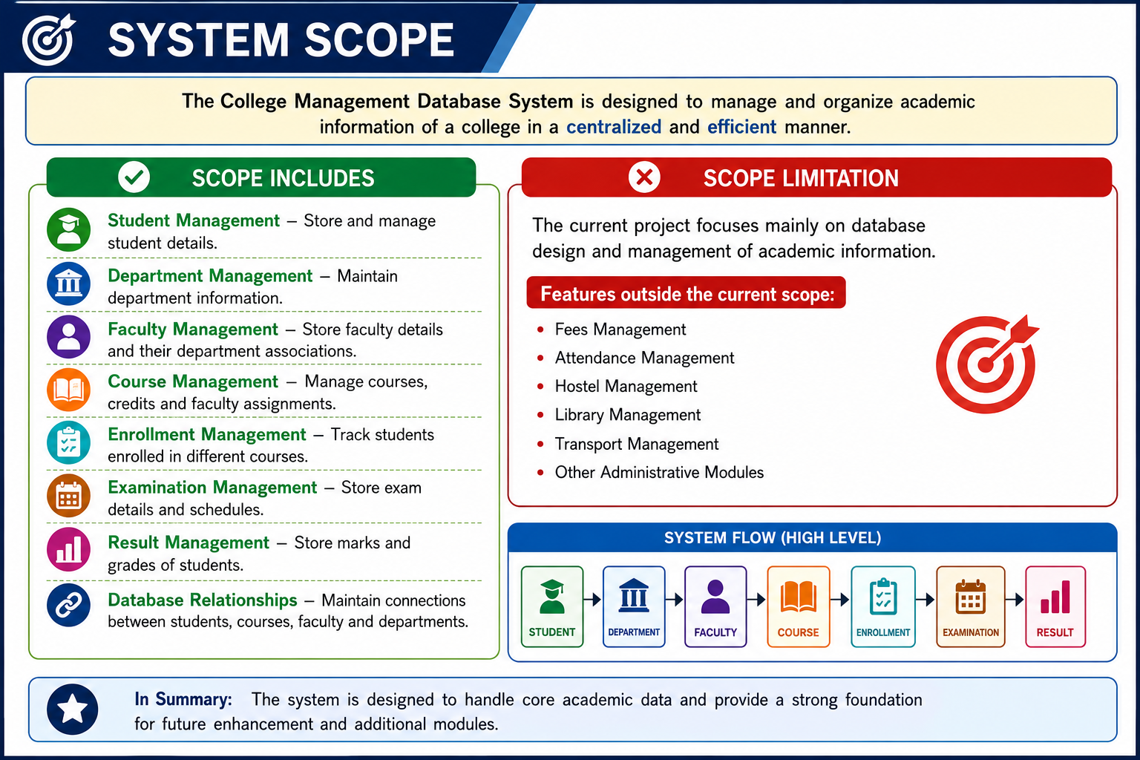

Slide 5
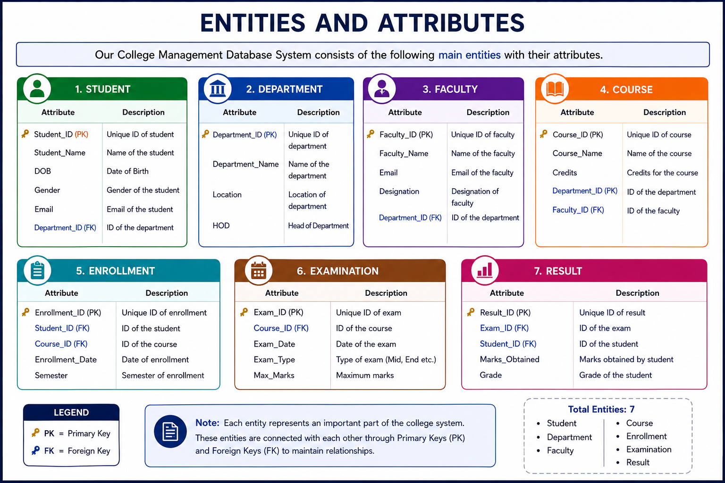

Slide 6
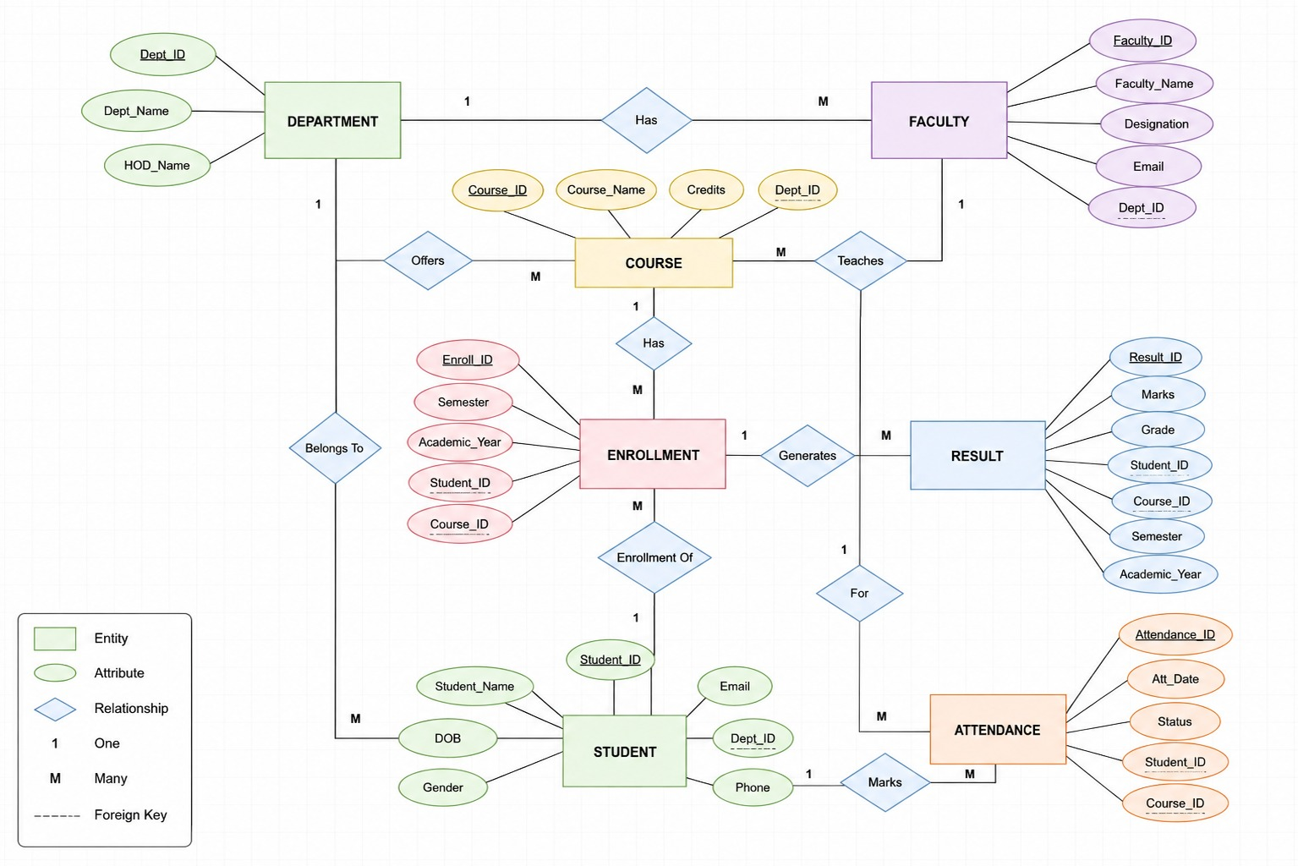

Slide 7
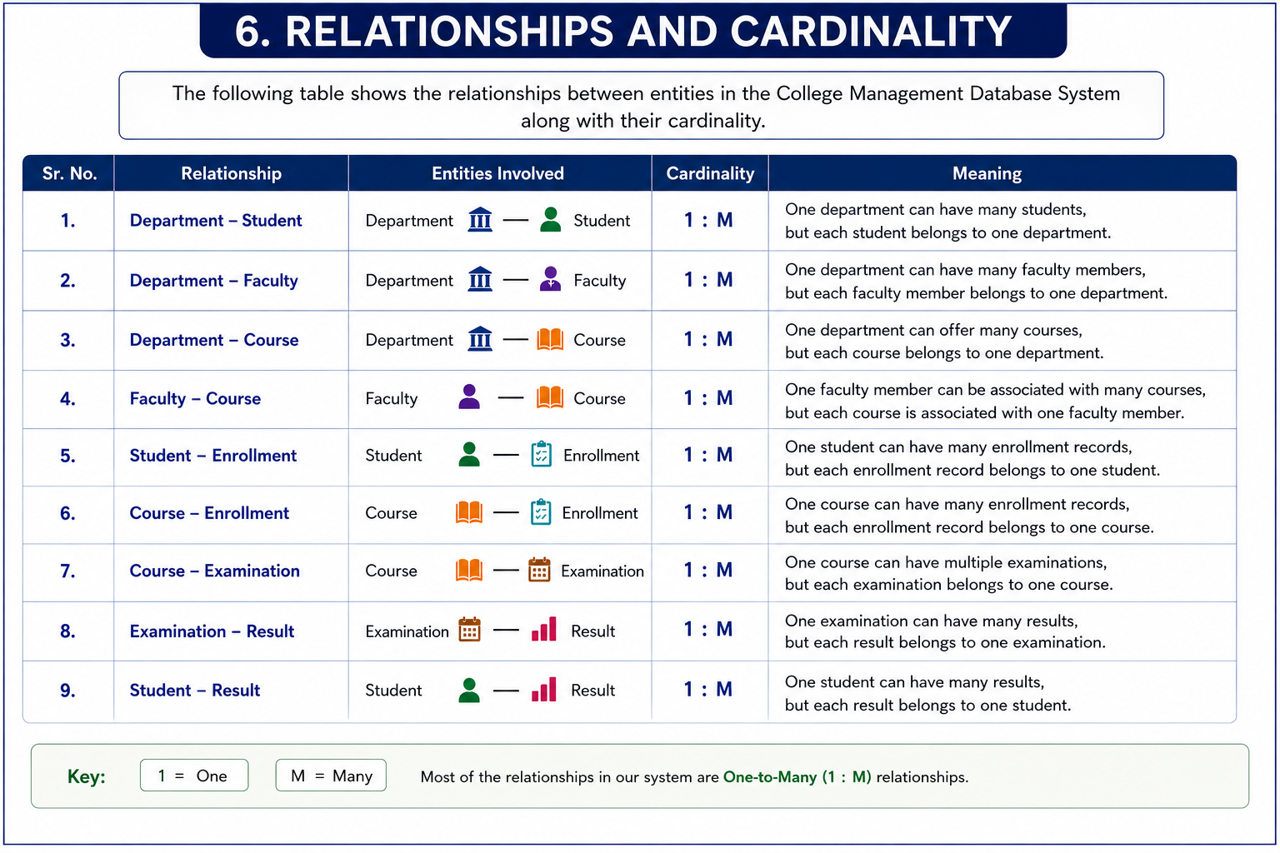

Slide 8
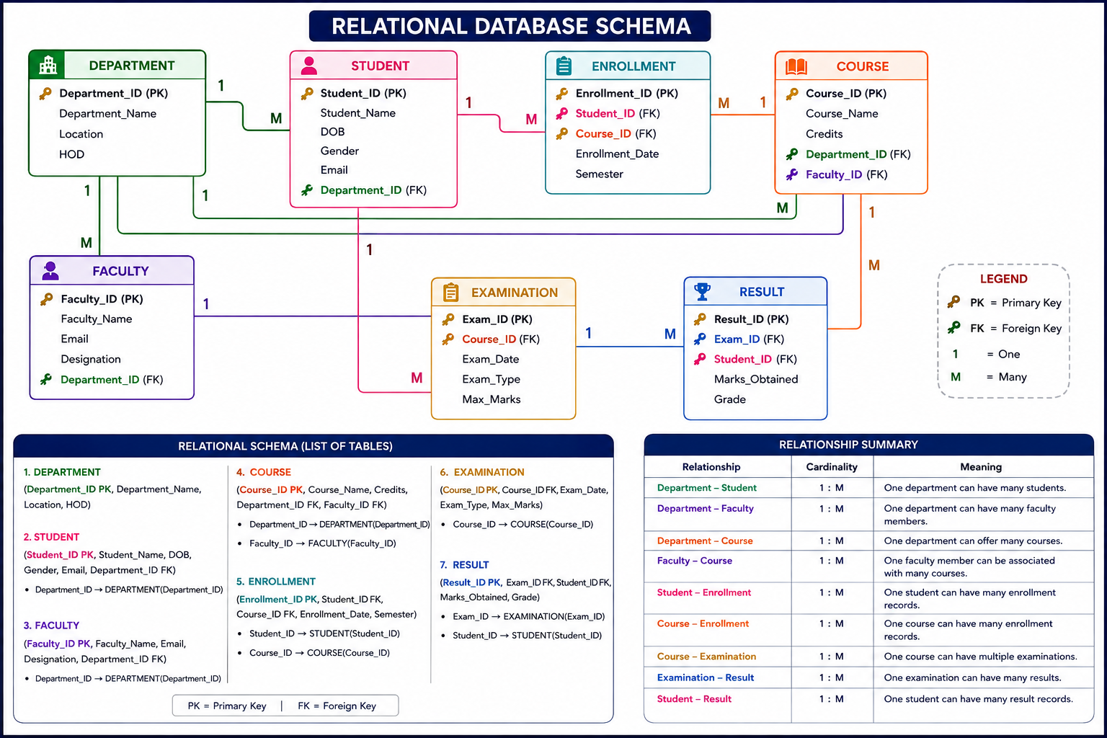

Slide 9
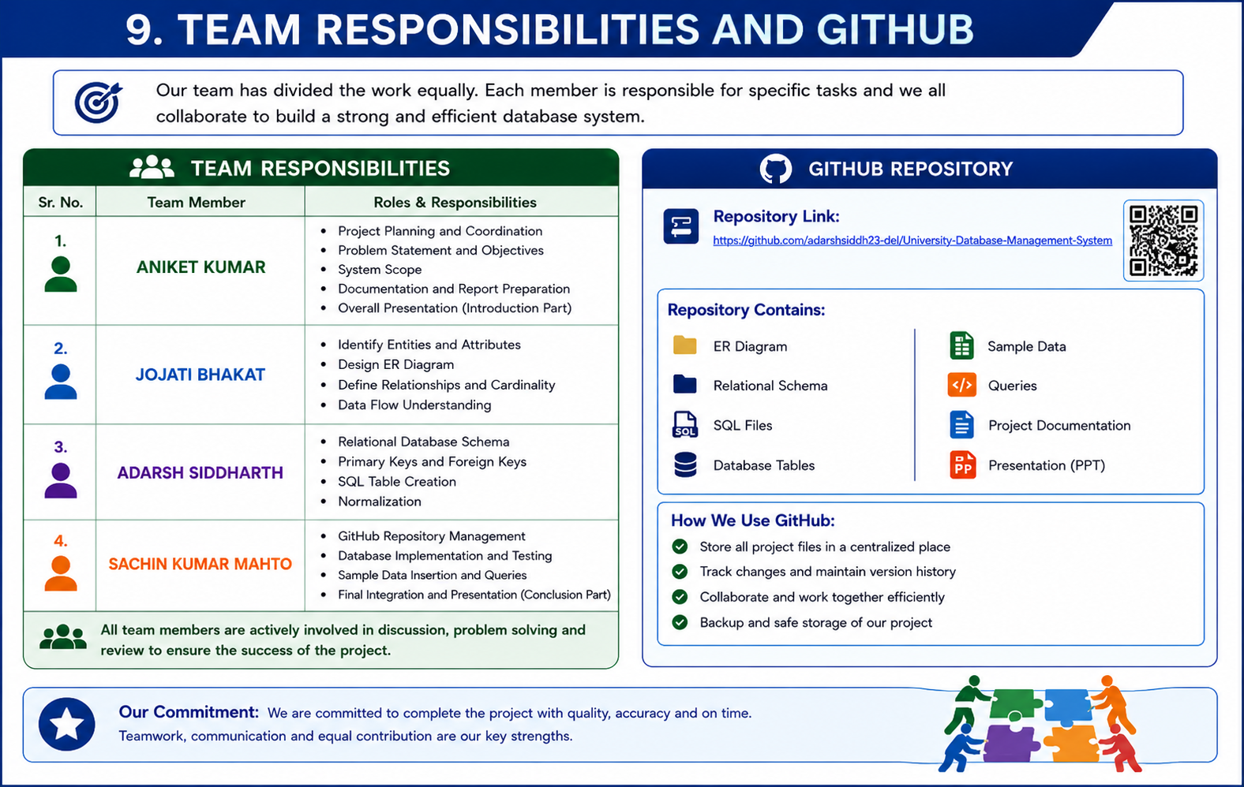

Slide 10
